Slide 1



Please download and install the Slido app on all computers you use
Welcome! While we wait for others to log on, join us for a game. This or That #1: Thin Mints or Carmel DeLites?
ⓘ Start presenting to display the poll results on this slide.

Slide 2
Please download and install the Slido app on all computers you use
Welcome! While we wait for others to log on, join us for a game: This or That #2: Cookie Booths or Door to Door Sales?
ⓘ Start presenting to display the poll results on this slide.

Slide 3
Please download and install the Slido app on all computers you use
Welcome! While we wait for others to log on, join us for a game. Toast YAY!: yay or nay?
ⓘ Start presenting to display the poll results on this slide.

Slide 4
2025 Community & Area Cookie Volunteer Training
Notes:
(Rachel will start the recording now, before Tammy starts)
Tammy - Welcome everyone to the 2025 Community & Area Cookie Volunteer Training! On behalf of the entire Product Program Team, we’re so delighted to have you with us today as we start to gear up for a new cookie season! Your dedication and energy make cookies possible, and we are so grateful for all that you do! We have a lot to share with you, so let’s get started!

Slide 5
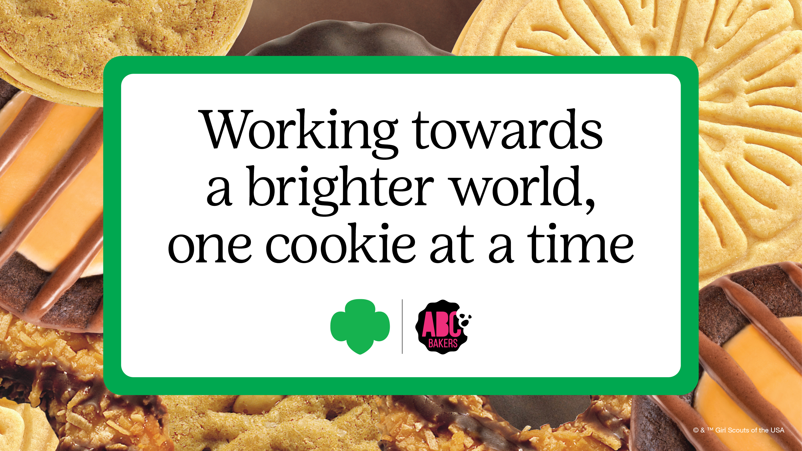
Before We Get Started…
Update your name to include your name & pronouns.
  Click on participants, find yourself, then choose More>Change Name
Remain muted to eliminate background noise.
Resources mentioned available in one handy spot!
This session is being recorded and added to gsLearn for later viewing.
Notes:
Tammy- We have a few items to cover as we begin our training:
If you haven’t already, please update your participant name to include your name and your preferred pronouns. Click on participants, find yourself, then choose More>Change Name from the menu.
Remain muted to eliminate background noise.
We will mention a wealth of cookie resources available to you. Don’t worry, you don’t have to memorize them! We’ll have them available in one handy spot so you can easily click on a link to bring you to the resource.
This session is being recorded and will be shared in gsLearn for those unable to attend one of our live sessions or if you’d like to review it later.

Slide 6
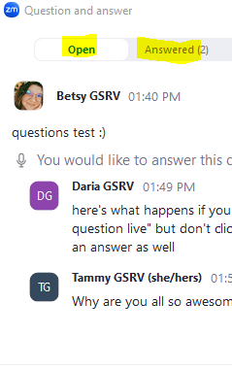

Using the Q&A feature
Notes:
Tammy-
We know you are a curious group that has a lot of questions. You’ll notice we do not have the chat function, rather, we are using Zoom’s Q&A feature instead.
Select the "Q&A" button on the bottom, left-hand side, or in the "More" section depending on your device.
You can view Open questions in the Open tab of the Q&A pop-up, as well as the questions we’ve already answered or will be answered in the Answered tab.
We’ll answer some questions live after the training, and also provide you with an FAQ document that will be emailed after all our sessions are complete
My name is Tammy from the Product Program Team and I’m being joined by some terrific team members today, including Becky, Betsy, Daria, Jen, Meylani, and Rachel, and Anne from ABC Bakers who will all take part in our training today. And now, it’s my pleasure to introduce our Chief Engagement Officer, Susan Andersson.

Slide 7

A Message from Susan Andersson, Chief Engagement Officer
Notes:
Susan additional message – 5 min

Slide 8
Session Topics
2025 Program Updates
Important Cookie Dates
Online Cookie Systems Updates
  Smart Cookies
  Digital Cookie
Guidance & Resources for Troop Cookie Manager Training
Cookie Finances for Troops
Q&A
Notes:
Tammy–
Based on volunteer feedback, today we will focus our time on the key program updates to equip you with what you need to know to support the troops in your Communities. For our Community Cookie volunteers that are new to your role, make sure to review our 477 Community & Area Product Leader Foundations-Cookie Program course in gsLearn to review the basics of your role. The major elements of the Cookie Program aren’t changing, including the initial order, deliveries, cookie cupboards, booths, etc. Sharing this information should take just over an hour. During this time, we’ll review:
The 2025 Program Updates​
Important Cookie Dates​
Online cookie systems updates for volunteer for Smart Cookies & Digital Cookie
Guidance & Resources for Troop Cookie Manager Training
Cookie Finances​ for Troops
At the end of the training, we’ll wrap up with reminders and an optional Q&A session with our team.

Slide 9


2025 Program Updates for Girl Scouts
New Mascot & Theme
New Cookie Proceeds for Troops & Communities
  $1 per package
    All cookies are $6 per package
  Opt-out option continues for Senior/Ambassador Troops
  $.01 per package for Communities
    $500 cap
Final Year for the Toast-YAY!
  Commemorative patch initial order reward
Notes:
Tammy-
Alright everyone, let’s dive into what’s NEW for the 2025 Cookie Program! We’ve got some exciting updates to share, so let’s break it down:
First up, a brand-new mascot and theme! The face of the program is Noodles the Panda with the theme of Embrace Possibility —it’s going to be a hit with the girls.
New cookie proceeds are coming for both troops and communities. All Troops earn $1/pkg. All cookies are still $6 per package. We still offer the opt-out option for Senior/Ambassador Troops to earn an additional .05/pkg. I also want to mention that all cookies are kosher and halal certified, you can find complete nutrition info on our website.
Communities will earn .01/pkg in proceeds on all packages sold, with a cap of $500. Make sure your community bank account record has been submitted to River Valleys, connect with Becky Rettler for confirmation.
And now, for some bittersweet news—it’s the final year for the Toast-YAY! That’s right, this cookie is heading into retirement. But don’t worry, we’re sending it off in style with a commemorative patch as an initial order reward if troops follow the Cookie Calculator recommendation. This does mean we’ll have a new cookie in 2026, expect the announcement of the new cookie in Summer of 2025!

Slide 10

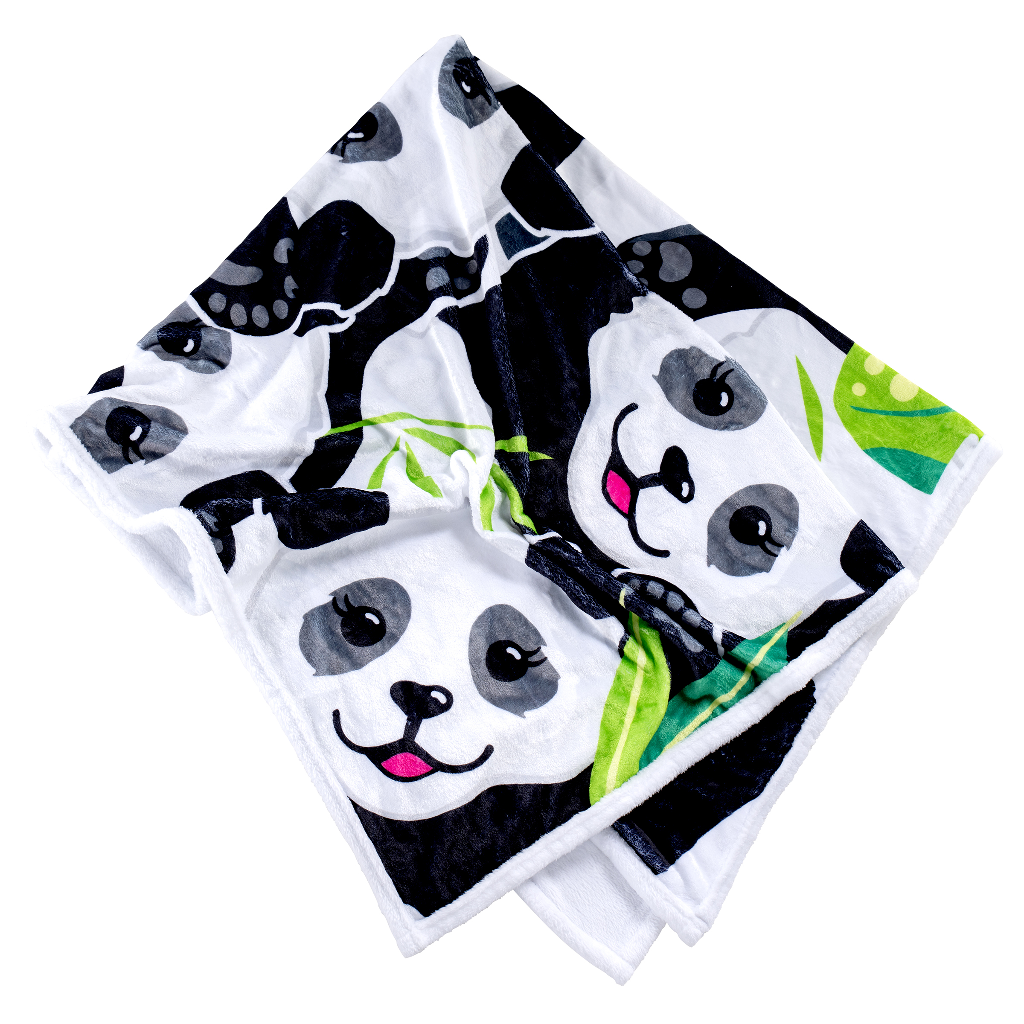

2025 Program Updates
Cookie Rewards
  New LemonAID Philanthropic Partner: Pet Haven of MN
  Cookie Credits begin at 60 packages
  Disney travel reward at 5000 packages, June 11-14
  New Troop Per Girl Average (PGA) Rewards
    Valleyfair Event on June 22
Notes:
Tammy- Let’s talk about the updates to our cookie rewards this season:
Our new LemonAID philanthropic partner is Pet Haven of MN. It’s a paw-some cause that girls can feel good about supporting with their efforts. Anyone who makes this choice will earn the LemonAID patch.
Cookie Credits start at just 60 packages! That’s a change based on your feedback.
For the go-getters, there’s the Disney Travel Reward for 5,000 packages. We’ll provide more details in our Rewards Fine Print on Cookie Central, but the cliff’s notes version is the trip is June 11-14, this is non-cumulative, which means girls would opt out of rewards at the 850-2000 level to instead take the trip, they still can attend Dream Team if making this choice. Transportation is on their own, but the accommodations, park passes, and a dining plan is all included in the trip.
We have new Troop PGA rewards! These include the popular panda neck pillow at the 300 PGA level, the panda blanket that is SUPER plush and available at the 400 PGA level, and finally, if a troop achieves a 500 PGA, they’ll have the choice to either receive a $25 membership credit for each girl selling and 2 adults or free admission to our first-ever Girl Scout Cookie Seller Day at Valleyfair event on June 22. All troops will be welcome to this event and can purchase discounted tickets for both members and family members too! Watch for more details at the end of our cookie season.

Slide 11


2025 Program Updates
Volunteer Communications
Rallyhood
  Council Wide Community Product Leaders – GSRV Rally
  Council Wide Troop Product Program Volunteers – GSRV Rally
  Cookie Swap Rallies
    9 new rallies based on geographic areas
Just-in-time Resources
  The Cookie Press
  Direct-to-Volunteer Emails
Notes:
Rachel - There are a multitude of ways we’ll communicate with Community-level and troop-level volunteers. We have several Rallyhood pages, including:
-the Council Wide Community Product Leader rally and the Council Wide Troop Product Program Volunteers rally. Any information shared in this troop rally will also be shared on our Troop Product Program Managers Facebook group.
We’ve also transitioned our Cookie Swap to Rallyhood, where we’ll have a variety of Cookie Swap rallies available for volunteers to join based on the Area of the Council that they live in. Volunteers can join one, or as many Rallies as they like. We’ve included the links to these rallies in our resources at the end of this presentation.
-And just-in-time resources will be used throughout the program to ensure you have what you need to successfully assist the volunteers and troops in your area. This includes The Cookie Press and other direct-to-volunteer emails.

Slide 12
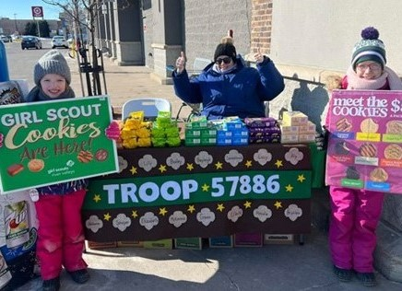
2025 Program Updates Cookie Booths
Updated Cookie Booth Guide & Booth Kit
Updated Cookie Booth Do Not Contact List
New List: Businesses Available for Troop-Secured Booths
  Note: GNC & Dunkin now available for troops to contact
Fall FUNDraiser bonus booth round
Notes:
Rachel - Don’t forget to check out the cookie booth resources available on Cookie Central, which includes our newly updated Cookie Booth Guide. Troops will receive the cookie booth guide in their print materials as well. This guide walks you through cookie booth basics, taking customer payments, additional selling tools, and more!
We’ve also updated our Do Not Contact list for this year. AND There is now a list of cookie booths that will no longer be secured by council beginning this cookie season. These businesses which are now available for troop-secured will be found in this new list.
So what does this mean? Troops can use this list to reach out to the individual stores for troop-secured booths. An example of two former council-secured booth locations that can now be troop-secured include all Dunkin Donuts and GNC stores. The Do Not Contact list and Businesses Available for Troop Secured list will be updated on Cookie Central soon and we’ll share the link in The Cookie Press as well. You can also find the links directly in this presentation.
And we know some have been asking already, and we haven’t forgotten. Troops who participated in the Fall FUNDraiser and sold $150.00 or more in product, we are still working on the details for the bonus booth round opportunity in Smart Cookies. Once the details are finalized we’ll reach out to those troops via email.

Slide 13
2025 Program Updates
Cookie Exchange & New Resources
Cookie Exchange Opportunities
Timeframe in progress, to be announced in The Cookie Press
Full, bakery-sealed cases
Caramel Chocolate Chip not exchangeable
Cupboard staff will be inspecting all exchanges
New Resource for First-Year Troops
Easy-Baked Cookie Program
  Designed to guide new troops on participation options
Notes:
Rachel - We are wrapping up with two more updates—Cookie Exchange Opportunities and a new resource for first-year troops!
First, Cookie Exchange Opportunities:
Keep an eye on The Cookie Press for the timeframe announcement. We’re still working on the dates and the details for the exchanges. This will NOT happen within the first two weeks. Exchanges will be limited to full, bakery-sealed cases, so plan accordingly. And just a heads-up—Caramel Chocolate Chip cookies are not eligible for exchanges. We hope knowing exchanges will be available will help to feel confident in placing an initial cookie order. We also ask you to spread the word that all exchanges will be inspected by the cupboard staff before accepting the exchange. Any cases that are NOT sealed or have missing or other cookie packages inside will be turned away. River Valleys will also consider ending exchanges should we see frequent exchanges that are not following these guidelines.
Now, for our new resource:
We’re introducing the Easy-Baked Cookie Program for first-year troops. This is designed to help new leaders navigate the cookie season with a menu of options that they can select from based on their comfort-level and time available. Our hope is that our newest troops can build a foundation with the basic elements of the sale, then continue to build on that foundation as they and their Girl Scouts progress with the Cookie Program. This resource will be emailed to new troops and posted on girlscoutsrv.org.

Slide 14
2025 Key Dates
Find these in the Community /Area Cookie Notebook &
Troop Cookie Companion
Notes:
Jen
Now let’s talk about the important dates that you should be aware of.

Slide 15
Important Community Product Leader Dates
Date | Event | Task
Now – Early Jan. | Schedule Troop Training | Attend online, virtual or in-person
Now – Early Jan. | Schedule Community Cookie Rally | Schedule, plan, and share date with Troops.
Dec. 22 | Cookie Rally Order | Submit order for cookies to purchase for a Community-led Rally
Week of Dec. 30 | Cookie Materials Ship to CPL’s | Arrange for Troops to pick up sales materials
Jan. 25 | Initial Order Deadline | Assist Troops with their Initial Order
Feb. 13 - 20 | Cookie Deliveries | Mega drops: Share delivery reminders/tips with Troops. Mini drops: Oversee delivery/distribute cookies.
Mar. 30 | Cookie Season Ends | Offer support/tips on how to wrap up the sale.
April 7 | Reward Deadlines for CPL’s | Adjust selections in Smart Cookies
Week of May 19 | Rewards Ship to CPL’s | Schedule pick-ups with troops
Notes:
Jen -
Following are the key Community Product Leader Dates:
You can begin scheduling your troop trainings anytime between now and early January. Also, if your Community is hosting a cookie rally, be sure to get it on the calendar and order cookies (and the optional sample rewards kit) for your event by December 22.
Troop cookie materials will ship to you the week of December 30 so you have the supplies needed to distribute to your troops in early January.
Inform troops of the type of cookie delivery your Community is assigned to and provide guidance and resources for determining their initial cookie order, such as the Cookie Calculator. You can make edits to the IO's until the January 25 deadline.
Mark your calendars for cookie deliveries starting February 13. Be sure to share reminders and delivery tips if your troops are assigned to a Mega Drop.
For Communities that participate in Mini Drops, you’ll oversee the delivery and assist in cookie distribution.
The cookie sale wraps up on March 30, then it’s time to focus on entering rewards. Community volunteers will have until April 7 to make any changes for your troops.
Finally, rewards will ship to you the week of May 19, so you can sort the orders, distribute the rewards to your troops, and celebrate a job well done!

Slide 16
Important Troop Volunteer Dates
Find These Dates in the Troop Cookie Companion
Date | Event | Task
Now – Early Jan. | Attend Troop Training | Attend online, virtual or in-person training hosted by your Community Product Leader
Now – Jan. 9 | Confirm Girl Scout Information | Confirm GS name, email in Smart Cookies for transfer to Digital Cookie
Jan. 24 | Initial Order Deadline | Enter order in Smart Cookies. Use the Cookie Calculator to help determine the order.
Feb. 13 - 20 | Cookie Deliveries | Prep/Go to Assigned Mega/Mini Drop
Feb. 12 | Cookie Pre-sales & Online Sales Begin | Share Digital Cookie sales links; take pre-orders on the order card
Feb. 21 | Cookie & Booth Go Day | Participate in cookies in hand sales, deliver pre-orders, engage in booth sales.
Mar. 30 | Cookie Season Ends | Last day for online sales, booths
April 6 | Reward Deadline for Troops | Input selections into Smart Cookies
Week of May 19 | Rewards ship to CPL’s | Schedule a pick-up with your Community Product Leader
Notes:
Jen
Turning to the important cookie dates for troops, here are a few highlights for the season:
Once troops access Smart Cookies for the season, we want them to confirm the information is correct for their Girl Scouts before it is transferred to Digital Cookie. We’ll talk more about this date shortly.
The Troop Initial Cookie Order Deadline is January 24.
Next, Cookie Pre-sales & online sales in Digital Cookie will start on February 12.
Cookie & Booth Go Day begins on February 21 to coincide with National Girl Scout Cookie Weekend.
The deadline for troops to enter their reward choices is no later than April 6.
And cookie money deadlines will be covered later in this training.

Slide 17
Online Cookie Systems Updates
Notes:
Tammy
Next on the agenda, we’ll cover the enhancements for our Online Cookie Systems for the upcoming season for both Smart Cookies & Digital Cookie.

Slide 18

2025 Smart Cookies &
Digital Cookie Updates
Improved user access
Faster updates
Expanded payment options in the mobile app
Notes:
Tammy - After taking in feedback from families, volunteers, and council staff, the Digital Cookie team at GSUSA has worked on smoothing out the Girl Scout & Troop experience for 2025.
The updates they’ve made, which we will cover in this section, focus on user access, faster updates between both systems, and expanding payment options in the mobile app.

Slide 19

New! Online Cookie Systems Guide
  Find it on Cookie Central
  All instructions and videos for volunteers in one spot
  Features Digital Cookie Connections to callout when/how the systems connect
  Just in time reminders & instructions in The Cookie Press
Notes:
Tammy
Based on your feedback, we’ve revamped our volunteer resources for the systems used to manage the sale! We’re excited to introduce the new Online Cookie Systems Guide—a one-stop hub on Cookie Central for Smart Cookies and Digital Cookie from the volunteer role. No need to jump between two guides, it’s all in one spot. This guide includes updated instructions, videos, and a new feature called Digital Cookie Connections, which explains where the two systems align. You’ll find the Digital Cookie Connections in the Smart Cookies info. For example, you can now learn how to use reports to compare Digital Cookie and Smart Cookies data or how to view Girl Scout Digital Cookie sales directly in Smart Cookies.​
Alongside this guide, we’ll share timely reminders and tips in The Cookie Press. When you’re training troops, we know the systems can seem overwhelming. There’s no need to learn all the things right away. Direct troops to these resources, share your own navigation tips, and reassure them they’ll get the guidance and instructions they need, right when they need it.​

Slide 20
Smart Cookies Updates
Notes:
Tammy
Now, let’s focus on what’s new with Smart Cookies. Good news! There are no major changes to the volunteer experience in Smart Cookies. The way you place your initial order, select a delivery location, transfer cookies, select booths, use the Smart Booth Divider-you get the idea-it all will work the same this year.
Please welcome Anne with ABC Bakers who will go over the updates made to Smart Cookies.

Slide 21



Smart Cookies Updates
Faster Updates Between Systems
Smart Cookies will pull data from
Digital Cookie on a scheduled basis
Troop to girl transfers completed in Smart Cookies will appear quicker on the Digital Cookie dashboard
Notes:
Anne – Hello everyone! It’s great to connect with you all today to share the enhancements you’ll notice with Smart Cookies this season.
The biggest change for Smart Cookies is the way sales information will transfer to Digital Cookie. The Digital Cookie Team heard your input about the frustrations that occurred when the updates were so very slow after cookies were transferred to girls in Smart Cookies. Now, Smart Cookies will be pulling data from Digital Cookie on a scheduled basis. This process should assist with updates in the system to be seen in minutes on the Girl Scout’s Digital Cookie dashboard, instead of hours or days.

Slide 22
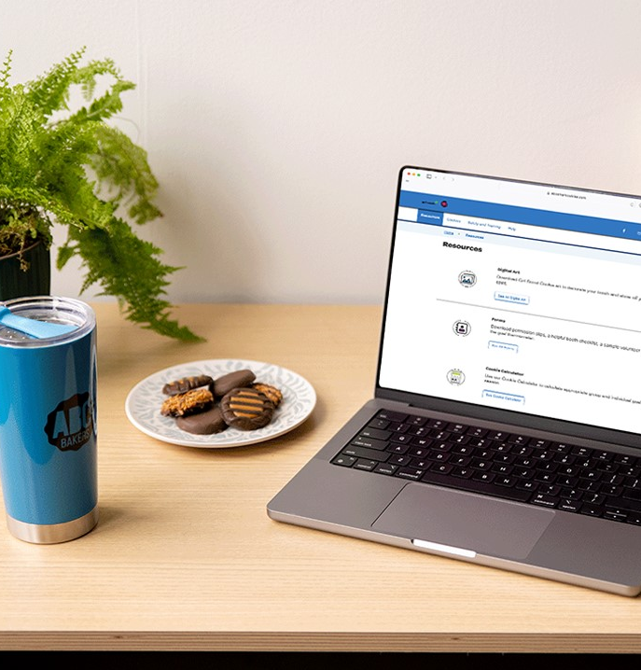
Smart Cookies Updates
New process to send Troop & Girl Scout data from Smart Cookies to Digital Cookie
Action Needed: Before January 9, verify information is accurate in Smart Cookies
Communities ensure all Troops are listed
Troops ensure all Girl Scout info is correct
Connect with River Valleys Staff to update any information
Notes:
Anne –Another enhancement this season is ensuring we have the most up to date information for troops and Girl Scouts in Smart Cookies before we transfer the information into Digital Cookie. The River Valleys Team has added all Troops and Girl Scouts that were registered as of December 1 to Smart Cookies. Before the send that information to Digital Cookie, we need your help to ensure the information is as accurate as possible. ​Here's how you can help:​
As a Community or Area Product Leader: Review your list of troops against your Looker report by January 9. If all troops are there, no further action is needed. If any troop is missing or you have a troop listed that shouldn’t be in your Community, reach out to River Valleys to have the edits completed.
For Troop Volunteers: We ask that they verify that all Girl Scouts are listed correctly in their troop, also by January 9. If any information is incorrect or missing, reach out to River Valleys to make any changes.​ If everything is accurate, no further action is needed.
River Valleys will continue to add and newly formed troops and newly registered Girl Scouts to Smart Cookies throughout the entire cookie season.

Slide 23
Smart Cookies Volunteer Access
Smart Cookies registration emails
    week of December 16
Community volunteers have Service Unit access
Area volunteers have District access
Two troop contacts
    Troop Cookie Manager & Troop Leader
Contact GSRV
    Smart Cookies Training Site for Troops
    Additional Users added, contact before 1/9
Notes:
Anne- When will you get access to Smart Cookies for the season? Registration emails will be sent the week of December 16. Even though River Valleys has made the change from Service Units to Communities, Smart Cookies will still feature the Service Unit terminology. All Community Product Leaders and Community Leaders will have Service Unit level access. Area volunteers will have access to all the Communities they help to support using District level access. ​​
For troops, two contacts are added: the troop cookie manager and troop leader. Troops can request to provide additional users with access to the system by contacting River Valleys staff. It would be terrific to have these additional troop users added in Smart Cookies before January 9, when they are transferred into Digital Cookie for the season. Don’t worry, if that date is missed, users will still be added, but they will not be added to Digital Cookie until the next day after Smart Cookies and Digital Cookie sync overnight.​​
Do you want access to the Smart Cookies training site for your troop training? No problem! We can provide you with a login and password. Just connect with the Product Program Team to request that access with a few days advanced notice.

Slide 24

Additional Smart Cookies Support
Girl Scouts River Valleys Staff
Smart Cookies Help Desk for Volunteers:
  ABCSmartCookieTechSupport@hearthsidefoods.com
  855-444-6682
Safety and Training tab in Smart Cookies
Notes:
Anne - Finally, if you or your troops need any additional Smart cookies support, it’s available for you! River Valleys staff is ready to help troubleshoot issues or provide reassurance when you need it. Here at ABC Bakers, we have a Smart Cookies Help Desk exclusively for cookie volunteers. You can reach them by email or by phone, 7 days a week from 8am-11pm. And you can access the Safety and Training tab in Smart Cookies with quick links to training videos right in the site. The training videos have been updated for this season too. On behalf of everyone at ABC Bakers, we thank you for your support of this vital program and we look forward to once again providing Girl Scouts River Valleys with the best tasting cookies for your customers.
And now I’ll turn it over to Rachel and Betsy to cover Digital Cookie.

Slide 25
Digital Cookie Updates
Notes:
Rachel - Thanks Anne! Let’s move along on now to dig into the Digital Cookie updates for this upcoming season!

Slide 26
Digital Cookie
Access Dates
Improved Customer Check-out Experience
Updated Features for Girl Scouts and Troops
New Resource for Tracking Family Inventory Need
Notes:
Rachel - Here’s an overview of the Digital Cookie updates. We’ll look further at each of these shortly.
-we’ll review the access dates for Volunteers
-take a look at an improved Customer Check-out Experience
-review the updated features for Girl Scouts and Troops
-and introduce a new Resource to help families track their cookie inventory

Slide 27
Digital Cookie Access
Volunteer access to Digital Cookie begins January 24
  Digital Cookie Test Site Access Available
Girl Scouts and families will receive access to Digital Cookie via a registration email on February 1
Notes:
Rachel
So when will you get access? Volunteers will receive access to DC on Jan. 24. If you’d like access to the Digital Cookie test site to use for your troop training, contact us for a login and password. Girl Scouts & their families will receive access to DC via a registration email on Feb. 1

Slide 28
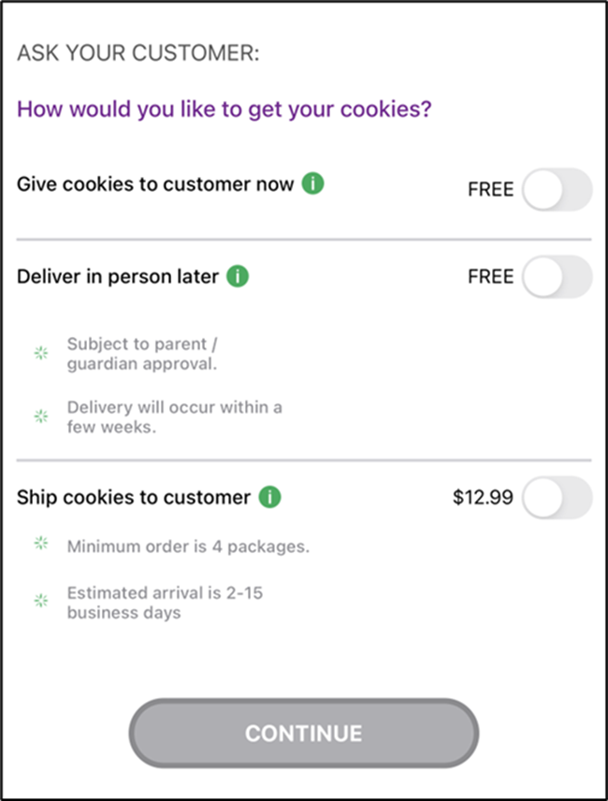
Digital Cookie Mobile App Enhancements
    Improved Customer Check-out Process:
    No longer required to fill in customer name, email, zip for Give Cookies to Customers Now
    Girl Scout login on Mobile App:
    No more differentiation between sold at booth or not sold at booth
    Renamed as Give cookies to customer now
    Update the Mobile App on Devices
Notes:
Rachel
Now, Let’s look at the Customer Experience in Digital Cookie…specifically the mobile app enhancements that customers (and girl scouts) will notice while they are checking out using the mobile app:
-first, there’s an improved check out process for customers and volunteers, where they’re no longer required to fill in their name, email, or zip code for “give cookies to customers now” sales. More on what that means in a moment.
-The Girl Scout login on the Mobile App has removed the differentiation between “Sold at booth” and “not sold at booth”. Instead, Girl Scouts when logged into their Girl Scout view will see “give cookies to customers now”. This will help to eliminate confusion when Girl Scouts are selling on their own, using their own inventory. When logged into the troop view of the mobile app, users will still see “sold at booth” vs. “not sold at booth”
-Lastly, all users should update the Digital Cookie Mobile app before Cookie Go Day, to ensure that when they login they will have full access to all these great enhancements

Slide 29
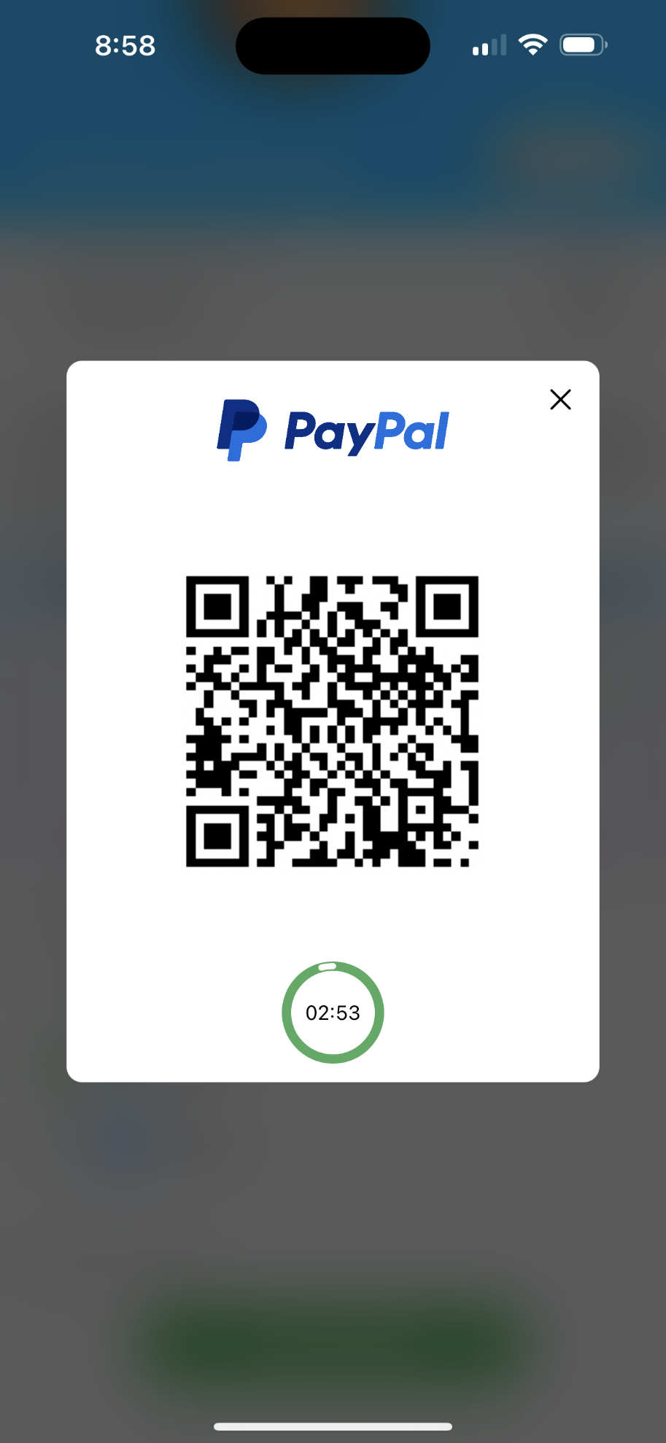
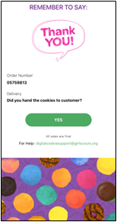
Digital Cookie Mobile App Enhancements
Venmo and PayPal available for Give Cookies to Customer Now
Customers will scan the QR Code with their own cellphone to complete payment
Thank You Confirmation Screen
Venmo/PayPal payments go to River Valleys directly and not a troop or Girl Scout Venmo/PayPal account.
Demo
Notes:
Rachel
-Also, Venmo and PayPal are now going to be available for those “give cookies to customers now” on the digital cookie app
When Venmo or PayPal is selected, a QR code will pop up on the screen for customers to scan with their own cellphone and complete payment. Girl Scout/Caregivers do not need to give their cellphone to the customer. Payment is initiated on the Girl Scouts cellphone but is ultimately completed on the customers cellphone. After the payment has fully processed, the Girl Scout/Caregivers mobile device will receive an order confirmation screen and a reminder to thank the customer for their order.
Payments that are made through Venmo/PayPal go to River Valleys directly and not a troop or Girl Scout Venmo/PayPal account. Troops will see this credited in Smart Cookies. This is the same as a typical credit card payment made in Digital Cookie which comes directly to GSRV, and not into the troops bank account.

Slide 30
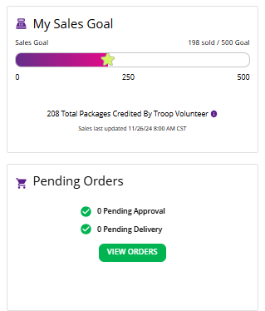
Girl Scout and Troop Experience
Simplified Progress Bar on Dashboard & Progress Bars update more frequently
Pending Orders visibility
Improved web view on phone, tablet, laptop
Notes:
Rachel
Girl Scouts and Troops will have a more simplified experience as well! Here’s the most important information to know:
The dashboard tab has several updates:
-the progress bar on the dashboard is more simplified & will update more frequently (woohoo!). We recognize that the progress bar can cause some confusion. Volunteers and Girl Scouts can see your Girl Scout’s progress toward her goal and see how many cookies the troop cookie volunteer has assigned to your Girl Scout.
Donated and In hand orders appear right away.
Shipped orders appear in the graph when the order ships. This can take a few days, orders don’t ship on weekends and holidays.
In-person delivery orders appear when the order is approved
Girl Scouts can add offline sales under the site setup page so customers can see a true representation of her sales.
-and all pending orders will also be more visible on the dashboard
-overall, the digital cookie web view is improved for users no matter their device (Cell Phone, Tablet, Laptop, etc.)

Slide 31
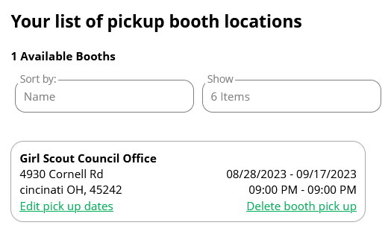
Girl Scout and Troop Experience
My Cookies tab – “Cookie Share” renamed to “Donate Cookies”
Booth Pickup tab – shows booth reservations
Booth Pickup Option for Pre-Paid pickup (rarely used)
  Use the Smart Booth Divider in Smart Cookies to allocate the packages to Girl Scouts for orders made using a booth pickup option
Notes:
Rachel
Now let’s check out the girl scout and troop experience updates-
The My Cookies tab has changed to better reflect donated cookies. Previously, “Cookie Share”, this language is now renamed “Donate Cookies” for better clarity.
The Booth Pick-up tab shows the existing booth reservations that a troop has secured in Smart Cookies. While used rarely, troops have the option to add pre-paid pick up for customers at booths using this tab. This pick up option replaces the troop virtual booth link from last year. If you utilize this option, you’ll use the Smart Booth Divider in Smart Cookies to credit packages sold to the Girl Scouts from the booth.

Slide 32

Girl Scout and Troop Experience
Cookie Donations: Council vs. Troop Inventory
Any donation can go towards Virtual Cookie Share (council inventory)
Donations that ONLY go to Virtual Cookie Share (council inventory):
Donations accepted from a digital cookie shipped-only order
Donations accepted from the troop’s booth pick up link.
Most donations can go towards Tracked Cookie Share (troop inventory)
View Managing Cookie Donations in Smart Cookies tip-sheet
Notes:
Betsy (Thursday, Monday); Meylani (Saturday)
Let’s talk about Donations and Digital Cookie (and Smart Cookies). For more details, you can refer to the Online Cookie Systems Guide or this PowerPoint later.
A common question we get is how to know if a donation counts towards a troop’s inventory (Tracked Cookie Share) or the council’s inventory (Virtual Cookie Share). Here’s a breakdown:
Most donation types can go to Tracked Cookie Share, which comes from the Troops cookie inventory.
ANY donation type can go towards virtual cookie share, which comes from council’s inventory at the end of the sale.
in both of these instances, the troop volunteer has action needed in smart cookies to identify if they want a donation to be tracked or virtual, see the managing cookie donations in smart cookies tip sheet (on cookie central and in this deck) to assist with this process.
However, be aware that there are 2 types of donations that can ONLY go to the virtual cookie share, or council inventory. These are donations that come from a Digital Cookie Shipped-Only orders and booth pickup orders.
with Digital Cookie Shipped-only orders: Donations are automatically credited to the Girl Scout and show up in the Virtual Cookie Share, no further action is needed by the troop volunteer.
with Booth pickup orders: Donations are automatically credited to virtual cookie share and will appear in the Virtual Booth Pending Distribution. Use the booth divider to credit Girl Scouts with these booth pick up sales. Detailed instructions for this action are in the Online Cookie Systems Guide on Cookie Central.

Slide 33
Girl Scout and Troop Experience
  Viewing Girl Scout and Troop Donation Orders Made in Digital Cookie & Smart Cookies
Notes:
Betsy (Thursday, Monday); Meylani (Saturday)
So, you may now be wondering, how do I go back and find some of these donations? Let’s review where you can find donations made using the Digital Cookie platform on both Digital Cookie and Smart Cookies. Let’s watch together how we can view these donations on Smart Cookies and Digital Cookie. You can also view these instructions written out on another slide in this slide deck later on.

Slide 34
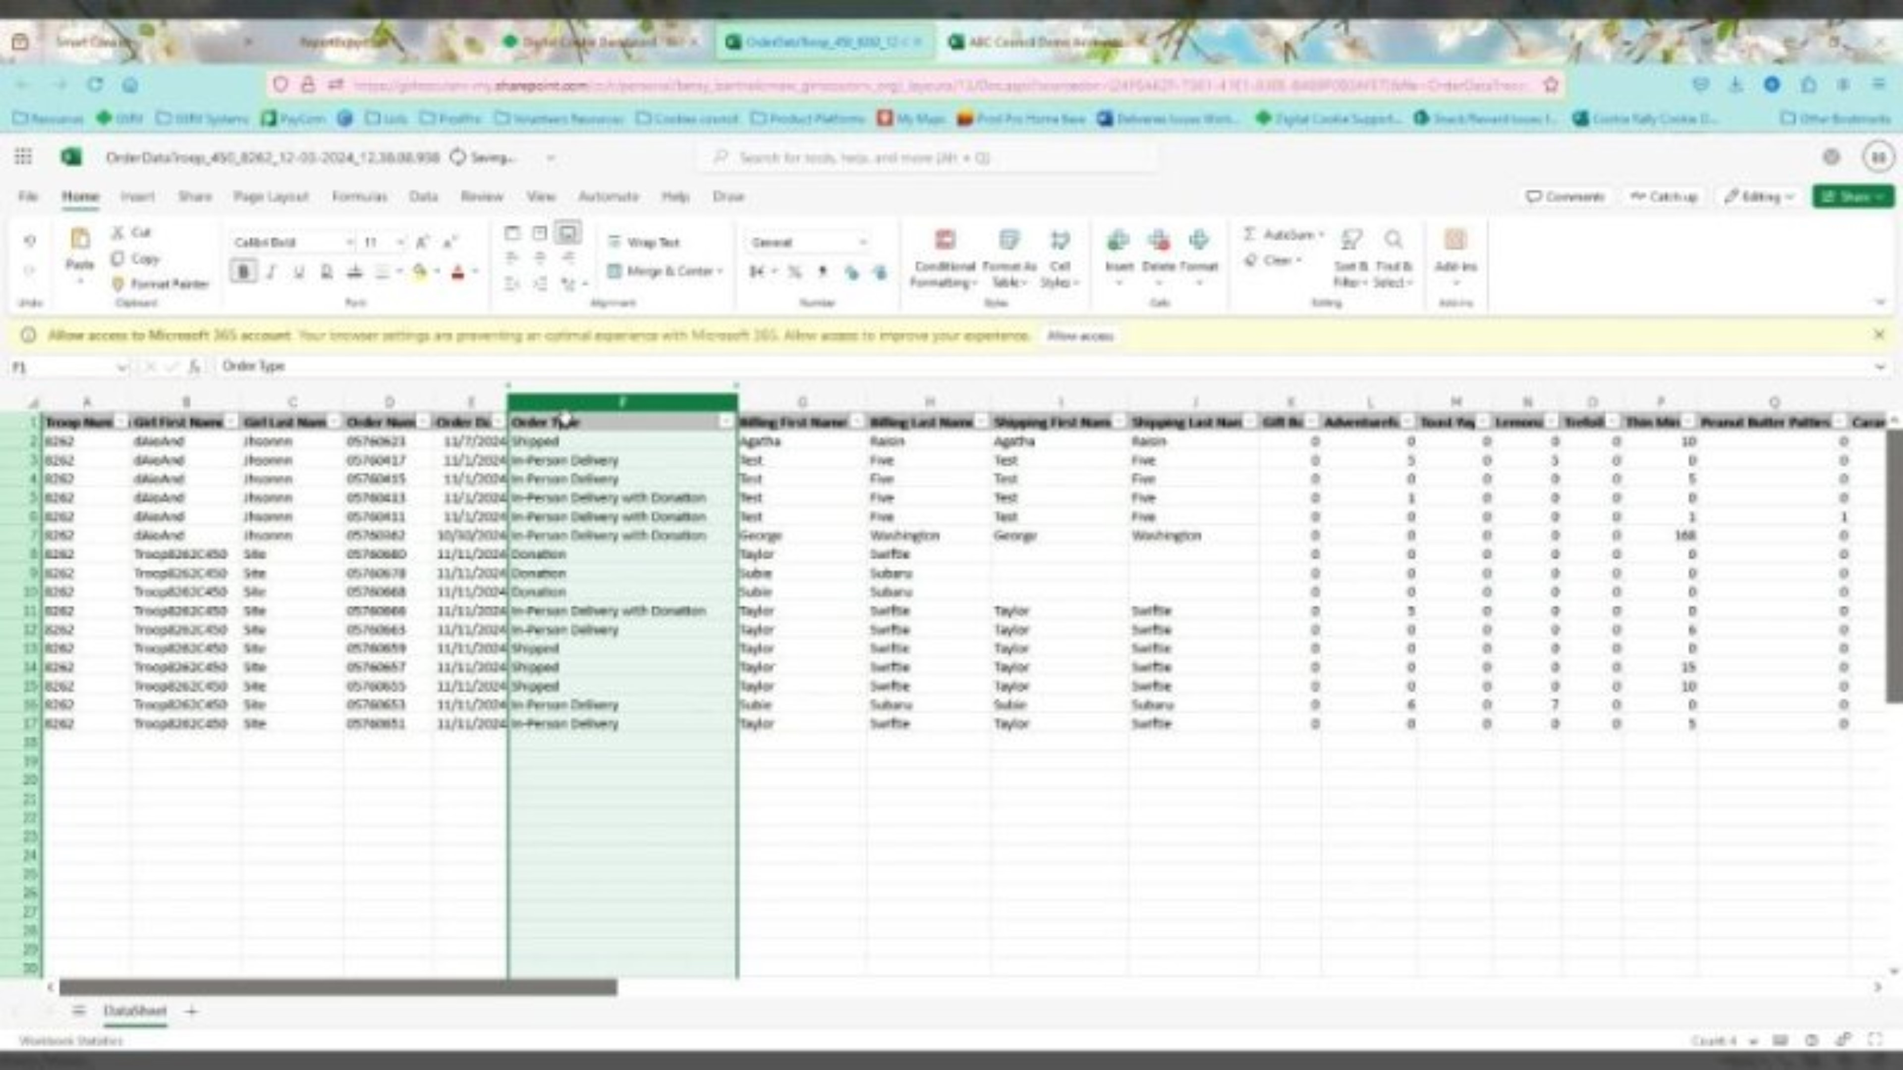
Viewing Donations
Notes:
Betsy (Thursday, Monday); Meylani (Saturday) - Read script from slide 34, if audio for this video is not working during our trainings.
(PLAY VIDEO)

Slide 35
Girl Scout and Troop Experience
  Viewing Girl Scout and Troop donation orders made in Digital Cookie:
  All Order Data Report on the Dashboard
  Filter the “Sales” column: Donation, In-person delivery w/ donation, Shipped w/ donation, and Cookies In Hand w/ donation
  If looking for Troop donations: the Girl Scout first name will be the troop site “Troop12345”
  Viewing Girl Scout and Troop donation orders in Smart Cookies:
  Girl Cookie Order Detail Report
  View shipped sales, in-person delivery, and cookies in hand sales with donations
  If Looking for Troop donations:
    Troop Ship Only Link: Orders tab>Troop Ship Orders
    Troop Site Link (In-Person Delivery): Booths tab>My Reservations>Virtual Delivery
    Pre-paid pick-up booth orders: Booth Credit Card Payment Export
Notes:
(This will be created into a video, hide this slide)
Both the Troop, with the Troop Sales Link, and individual Girl Scouts can receive donations from their cookie customers in Digital Cookie.
To view Girl Scout donation orders in Digital Cookie: pull up the All Order Data Report and filter for the following types of sales: Donation, in-person delivery w/donation, shipped w/donation, and cookies in hand w/ donation (from the give cookies to customer now sales).
To view Troop Site donation orders in Digital Cookie: pull up the All Order Data Report, filter for the sale types mentioned before, and look specifically for sales that have the Troop Site # as the first name (rather than the name of a Girl Scout).
You can also view these Girl Scout donations types in Smart Cookies, using the Girl Cookie Order Detail Summary Report. This includes; shipped sales, in-person delivery sales, and cookie in hand sales each of which include donations.
Viewing donations made to the Troop Site is a little more complex in Smart Cookies:
-Find donations made with the troop ship only link by visiting the Orders tab and viewing troop ship orders
-Find donations made with the troop site link for in-person delivery by visiting the Booth tabs, My Reservations, and searching for the Virtual Delivery row
-Last, to view donations made within a pre-paid pick-up booth order, open the Booth Credit Card Payment export in the Booth Credit Card Payments tab

Slide 36
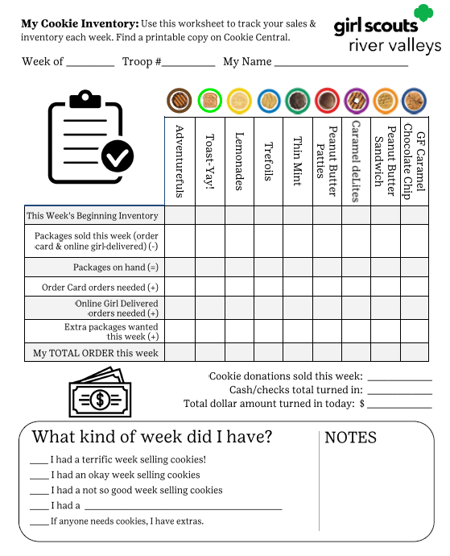
Girl Scout and Troop Experience
New Resource! My Cookie Inventory Worksheet
    Use to track inventory from cookie sales, donations, & cookie money
    Located on the back of the Family Cookie Guide and on Cookie Central
Notes:
Meylani –
Thanks for the donations help Betsy. Now, let’s talk about tracking cookie inventory. Based on feedback from last season, we’ve developed a resource to help families keep tabs on their Girl Scout’s cookies, donations, and cookie money. This is the My Cookie Inventory worksheet – which we recommend families use to help keep track of their inventory and their inventory needs for order card sales and online sales for local delivery. Plus, to track the donations collected and cash/checks turned into the troop. This worksheet is on the back of the printed Family Guide and a downloadable copy will be available on Cookie Central as well.

Slide 37
Girl Scout and Troop Experience
Shipping Promotion
Information will be announced in The Cookie Press
Minimum purchase of 4 packages for shipped cookie orders
Notes:
Meylani –
Now, let's chat about the type of sale that DOESN'T require any inventory tracking – shipped cookies! Troops and Girl scouts will be able to share links for shipped cookie sales again this season. To help make it a sweeter deal for those interested customers, we will once again have a shipping promotion during the season. We are still working on the details and once it is finalized, we’ll share it in The Cookie Press. As a reminder, there is a minimum required order of 4 packages of cookies for all shipped cookie orders. Customers will receive email updates, including tracking information, to keep them informed until their order arrives. Make sure to share the promotion details with your troops so they can promote it with their families.

Slide 38


Girl Scout & Family
Digital Cookie Resources
Available on Cookie Central:
Digital Cookie Help Center for Girl Scouts and Families
Tip Sheets & Videos Available
New Help Menu for Desktop Users:
“?” symbol available in top-right corner of Digital Cookie
Notes:
Meylani –
You can direct troops to Cookie Central to find resources to help their families navigate Digital Cookie, beginning with our Help Center. The Help Center features tip sheets and videos that covers topics such as mobile app payments, sharing their online cookie storefronts, turning on/off varieties, sending emails, approving orders, and more! We even have a comprehensive guide to download and print if needed.
And new this year, Digital Cookie has created a help menu for desktop users, with a mobile version of this coming soon. Within the desktop site, select the question mark symbol on the top-right hand corner. Users can review this menu to find:
-tasks to help them get started in Digital Cookie
-Quick links to: a live chat, tip sheets, video tutorials, and more for Girl scouts, their caregivers, and Troop volunteers

Slide 39
Training Your Troops
Presented by PPAC Members:
Amy Kornis
Eden Prairie Area Leader, Community Leader, Troop Cookie Manager, and Troop Leader
&
Maran Bush
Wayzata Community Leader, Community Product Leader, Community Treasurer, and Troop Cookie Manager
Notes:
Jen –
Whether you are an experienced product leader, or someone who will be conducting your very first troop training, your role isn’t just about sharing information. It’s also about inspiring excitement, providing tools for success, and creating a support system for your entire Community. When troops are effectively trained, the smoother the entire Cookie Program runs for everyone. This is why we will spend some time today reviewing tips and resources to help you complete this important responsibility of your role as Community Product Leader.
We are very fortunate to have a group of involved, creative, and talented volunteers who make up our Product Program Advisory Committee. They provide guidance and input from the volunteer perspective to our team throughout the year. Two members of the PPAC committee have recorded their top training tips to share with you today.
We’ll begin with Amy Kornis, Area and Community Leader, Troop Cookie Manager, and Troop Leader for Eden Prairie.

Slide 40
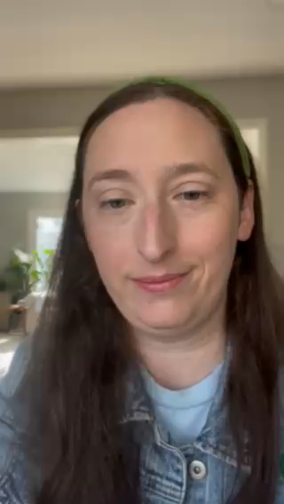
Amy’s Top Tips
Communication – Start Early!
Organization
Firm Boundaries
  Weekly Drop-in Zoom Meetings
  Stay up-to-date with transfers in Smart Cookies
  Keep paper documents/spreadsheets
  Make a cookie schedule and stick to it
Notes:
(PLAY VIDEO)
Communication – Start Early!
Weekly communications via email, Facebook, or Rallyhood
Weekly Drop-in Zoom Meetings
Organization
Receipts, Receipts, Receipts!
Make sure to count every box and dollar exchanged
Stay up-to-date with transfers in Smart Cookies
Keep paper documents/spreadsheets
Set (and keep) Firm Boundaries
Make a cookie schedule and stick to it
Share your communication preferences

Slide 41

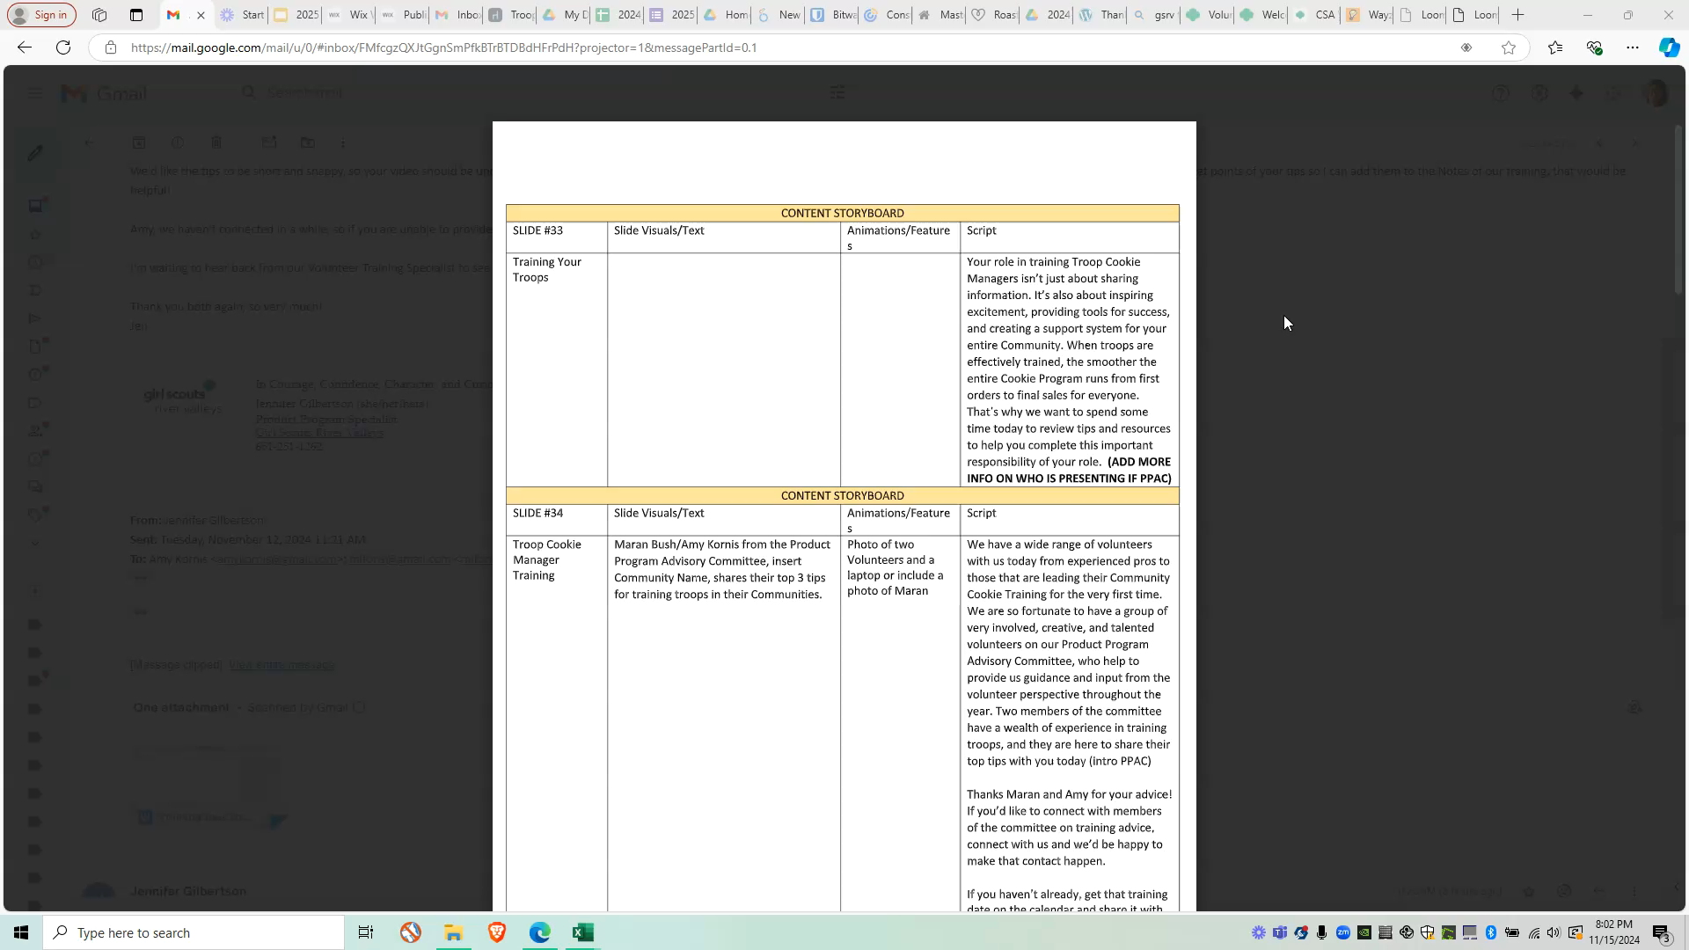
Maran’s Top Tips
Lay the Groundwork - Know Your People
Intentional Communication - Methods and Frequency
Encourage Troops to find a Troop Cookie Manager
Gather contact information for the Troop Cookie Manager
  Identify communication methods with troops
    Email, Facebook, and/or Rallyhood
    Start a new thread weekly to keep it current
Notes:
Jen
Thank you, Amy, now we’ll hear from Maran Bush, Community Leader, Community Product Leader, Community Treasurer, and Troop Cookie Manager for the Wayzata Community
(Skip ahead to PLAY VIDEO)
Tip 1: Lay the Groundwork - know your people
Remind troop leaders to discuss cookie sales with their girls and find a troop cookie manager
Collect information from your troop leaders for the sale (Google forms works great for this)
Selling cookies? yes/no
Who is the TCM? Name, phone, email
backup contact info (troop leader, 2nd TCM)
Tip 2: Intentional Communication - methods and frequency
How will you communicate with TCM's and troop leaders?
Email/Facebook/Rallyhood
Start a new thread weekly to keep it current. Need/give/swap cookies

Slide 42
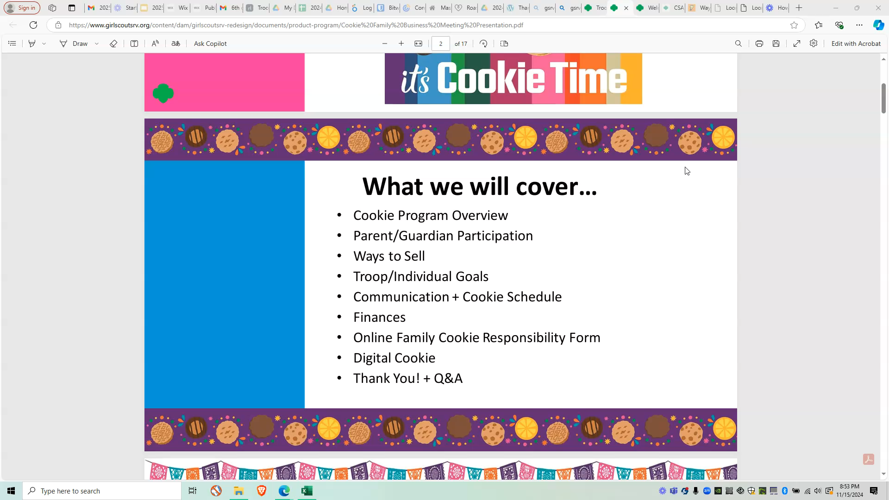
Maran’s Top Tips
Training Resources - Reviewing the Basics
The Cookie Family Business Meeting presentation and Tip-sheet
Notes:
(PLAY VIDEO)
Tip 3: Training Resources - reviewing the basics
Cookie Family Business meeting powerpoint has the minimum they and their families will need to know for a successful season
May be helpful to have new cookie managers review this before they attend a training.

Slide 43
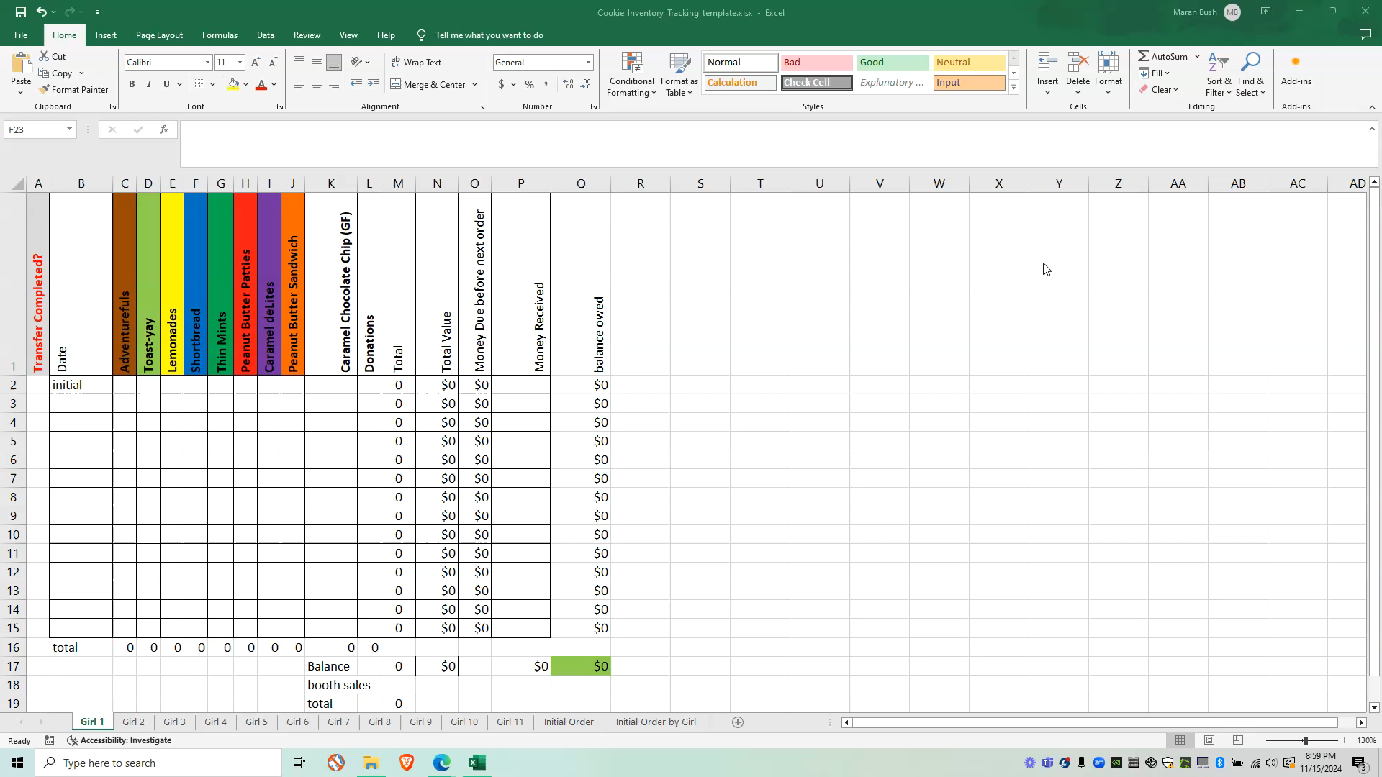
Maran’s Top Tips
Staying Organized - document, document, document!
  Receipts should always be given for cookie and money transactions
  Count cookie packages before and after cookie booths
  Keep good documentation. A spreadsheet can be helpful
Notes:
(PLAY VIDEO)
Tip 4: Staying Organized - document, document, document!
Receipts should always be given for cookies and money transactions
Count cookie packages before and after cookie booths (not the tally marks)
Keep good documentation. A spreadsheet can be helpful.
(AFTER VIDEO- Jen)
Thanks, Amy and Maran for your terrific advice! If you’d like to connect with members of the committee on training advice, reach out to us and we’d be happy to make that contact happen.
A few added training notes to keep in mind, the troop cookie supplies are arriving after the holidays, so it may be best to target early January to both hold the session and distribute the cookie supplies at the same time. For those of you who will be directing troops to complete the River Valleys online training, the training will be available in gsLearn by December 16.

Slide 44
The Essential Topics
Key Dates & Deadlines
Cookie Resources
Managing Cookie Inventory
Cookie Booth Guide
Cookie Proceeds & Rewards
Engaging Girl Scouts & Families
Community-specific information
Notes:
Jen
Let's go over the essential topics for training your troops. Covering these essential topics at training will ensure everyone is equipped with consistent messaging from Amery to Zumbrota and all places in between. These topics include:
Highlighting the key program dates & deadlines
Sharing resources, including print materials and Cookie Central. Encourage staying updated with our weekly Cookie Press emails for timely reminders.
Provide details on cookie delivery types, cupboard assignments, and initial order placement.
Review booth expectations, including how to interact with customers, handle conflicts, the importance of timely shift changes between troops, and following booth location policies. Coaching Girl Scouts and families on booth expectations is important, as booths are the most public way people see Girl Scouts in the community. Share your pro tips to ensure both the booth location and troops have the best experience possible.
Cover the updated cookie proceeds and rewards.
Discuss the Cookie Family Business Meeting and ways to involve Girl Scouts and families including goal setting, sharing tasks, staffing cookie booths, etc.
And finally, cover any community specific information, such as your cookie rally date, inventory transfer opportunities, available resources, and your preferred contact methods.

Slide 45
Resources to Train Your Troops
Primary Resource: Customizable Presentations in the Troop Training Toolkit on Cookie Central
Overview
Engaging Girl Scouts & Families
Managing the Cookies
Managing Cookie Finances
Smart Cookies & Digital Cookie
Supplemental Resources:
Troop Cookie Companion
Troop Cookie Guidebook
Booth Guide
Cookie Family Business Meeting Presentation and Tip Sheet
Online Cookie Systems Guide
Notes:
Jen –
However you train your troops, we have you covered with the tools and resources to get the job done. Our Troop Training Toolkit (available on Cookie Central) includes helpful tips on training. Plus, you’ll find editable and printable PowerPoint presentations. You can customize information to your Community or choose to use the presentations “as is.” You’ll find a copy of our presentation from today, a copy of our troop training presentations from our online training in gsLearn, and a detailed presentation on Digital Cookie. Don’t let your support end with training. Check in with troops ahead of sale deadlines with reminders and offers to support if they find themselves in need of guidance.

Slide 46
Cookie Finances
Becky Rettler – Troop Finance Specialist
becky.rettler@girlscoutsrv.org
651-251-1211
Notes:
Jen-
Your troops will likely have questions surrounding cookie finances during training and beyond. To help guide you on what to cover regarding finances during your troop training sessions, we’ll turn it over to Becky Rettler, our Troop Finance Specialist.

Slide 47
Cookie Finance Topics To Cover at Troop Training
Verify bank account information in Smart Cookies
  Update if changed or add if missing
  New troop accounts need to be opened by Feb. 1 and enter account information into Smart Cookies
2. Responsibility Forms are required for all participating Troop Cookie Managers and Girl Scout Families
Troop Cookie Managers
  Form due Feb. 1 (provide your email address)
  Set their Cookie Return Date for families
  Provide families with their email address
Family
  Form due before a Girl Scout receive inventory or takes online orders (including presales)
  Do not distribute or allocate cookies to Girl Scouts without a completed form
Notes:
Becky – First topic to cover at your troop training is to remind CMs to verify the bank account number that was uploaded into SC is correct for their troop. If it is incorrect or missing, they will need to fix. For your new troops, show them where in SC that information is entered and remind them their account needs to be opened by 2/1. I will copy you on emails I send to troops who have not entered their bank numbers.
Next review the responsibility forms that is required for all participating TCM and families to complete. Provide CMs with your email address so you will receive a copy so you will know who has completed or not. A suggestion would be to have CMs complete their form at your training or tell them it is due by 2/1. Also go over the importance of setting their troop cookie return date ahead of family cookie meeting.
At the troop family cookie meeting CMs need to share with families the troop cookie return date, what that date means, and their email address. CMs need to know that by giving their email to families, the family can add that to their form and then the CM will receive a copy so they can track who has completed or not.
Lastly, CMs need to know that a GS should not get inventory, take online orders, or have cookies allocated to them until form has been received.

Slide 48
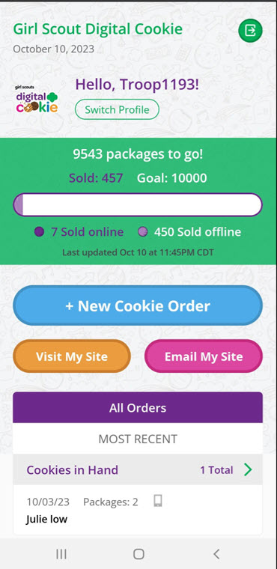
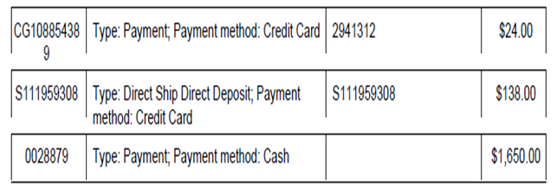
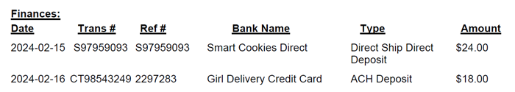
Cookie Finance Topics - Troop Training
3. Cash, Checks, Digital Cookie (Credit Card, Venmo, PayPal)
Payments are reflected in Smart Cookies on Girl and Troop Financial Transactions tab or Balance Summary Reports
Digital Cookie payments can be seen on the Orders tab on the web view and the Mobile app
Display "Payments Accepted" flyer in Cookie Booth Kit
Smart Cookies Financial Transactions
Girl Balance Summary Report
Smart Cookies Financial Transactions
Troop Balance Summary
Notes:
Becky – Next topic is to discuss the ways a customer can pay for their cookies. Along with using cash or checks, customers can pay with credit card, Venmo, or PayPal through DC. All payments made via DC will be credited to the troop and GS in SC & DC.
• In SC you can see all DC payments on both the girl and troop financial transactions tab or balance summary reports. Examples on bottom.
• DC payments can also be viewed on the orders tab on both the web view and mobile app for DC. Example on left.
• Please remind CMs to share with families that Venmo and PayPal customer payments can only be made through DC not personal accounts.
• Lastly, share with CMs to display the "payments accepted" flyer that can be found in the cookie booth kit to let customers know what forms of payments are being accepted for that troop.

Slide 49
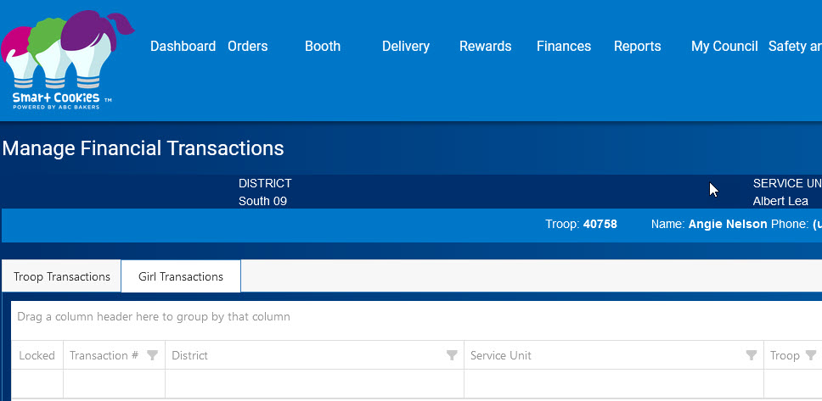

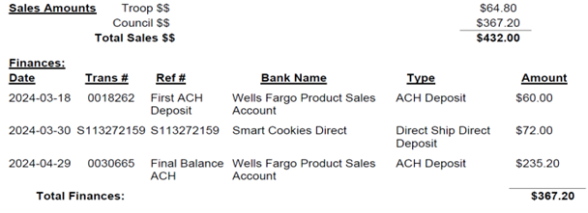
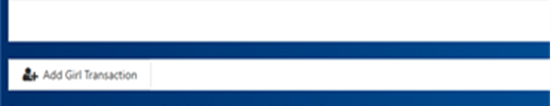
Cookie Finance Topics - Troop Training
4. Encourage Troops to collect cash/checks from families weekly
Set-up schedule - Deposit weekly - Record in Smart Cookies
Council $$ = ACH & Digital Cookie Payments
After May 2 ACH
  Total Finances Total should match Council $$ leaving ending balance of zero
  Troop Proceeds remain in troop account
  Receipts required for all money & cookie exchanges
Balance $0.00
Notes:
Becky - Next share that RV recommends troops to collect cash/checks from families and make deposits weekly. CMs should schedule a day of the week that money is to be turned in and record money received in SC under Finances tab – Girl Transactions.
Each year, I often get questions from new troops about when they’ll receive their cookie proceeds. Be sure to let them know that proceeds remain in their troop bank account. The only funds transferred out are those due to the council, which is the amount listed on their Troop Balance Summary Report. On Cookie Central, we have a great resource that outlines how cookie money works. Direct them to review this resource and connect with you if they have any questions.
Here I have an example from last cookie season. This troop sold 72 packages, which totaled $432. The troop gets a deposit credit for any ACH payments and Digital Cookie payments, which reduces the amount due to council at the end of the sale leaving troop with zero balance. The $64.80 proceeds stay in the troop account. The Online Cookie Systems Guide on Cookie Central features a breakdown of how to read the Troop Balance Summary Report.
Lastly on this slide, like Amy & Maren mentioned in their videos document, document so make sure CMs know that receipts are required for all money and cookie packages exchanges with families. If troop has a family that does not turn in all their money, we need copies of receipts to prove they took possession of cookies.

Slide 50


Cookie Finance Topics - Troop Training
5. ACH Dates & Amounts
First Balance Due ACH – Friday, March 21
  $1 x total packages received by troop as of March 14, minus any Digital Cookies payments
Second Balance Due ACH – Friday, May 2
  Final remaining balance at the end of the program
Proceeds Refund ACH – Friday, April 25
  Troops who are owed proceeds refund
See ACH FAQ on Cookie Central for more information
Notes:
Becky – Make sure to review the dates and amounts for the council-initiated ACHs. ACH stands for automated clearing house which is an electronic transfer between banks.
First ACH will be on March 21 and will be for $1 x total packages received by troop as of March 14 minus DC payments. Some troops will not have an ACH done due to amount of DC payments.
Second ACH will be on May 2 and will be for the final remaining balance owed by troop in SC.
We have some troops that only participated in taking online orders or had more DC payment so they would be owed their troop proceeds and that refund ACH will be done April 25.
Let CM's know emails with ACH amounts will be sent to main contact in SC prior to each of the ACH dates.

Slide 51
Cookie Finance Topics - Troop Training
6. Finance/Inventory Issue Form
    April 6 deadline for issues that will affect the amount of the May 2 ACH
      Excess (unsold) troop inventory
      Unpaid family or troop cookie manager balances
        Responsibility Forms and Receipts required
        Council takes over collections
    Returned Checks/Deposit Processing Fees/Counterfeit – do not affect May 2 ACH
7. Juliette Girl Scouts
    Deposit money into River Valley’s Wells Fargo account using deposit slips encoded with Juliette troop number
    Prior to Go Day, Juliette mentors will be mailed a letter with details on how cookie money works, deposit slips, and proceed range and amounts
See Finance/Inventory Issue Form FAQ on Cookie Central for more information
Notes:
Becky – Just a couple more topics and this next one is important. Please make sure to review the FIIF so CMs know the different issues a form can be submitted, the deadlines, and what documentation is required. A couple of the forms have a due date of April 6 that affect the troops May 2 ACH that I want to highlight with you.
If a troop has excess unsold cookie inventory at the end of the program, let them know to submit an issue form to request an extension to continue to sell to family and friends. The troop is still financially responsible for these cookies. The May 2nd ACH will be adjusted so we will not withdraw money these unsold cookies. The troop with have a third ACH later for the unsold cookies.
If a family or CM that has not turned in all their money to the troop, an issue form should be submitted with required resp form and receipts because again we don't want to withdraw money from troop account that has not been turned in. By submitting this form the council takes over collection from family or CM from the troop.
These issues don’t affect the May 2 ACH, but I know troops are not submitting forms when they should be.
If the troop account is charged a fee for a returned check, or cash deposit processing fee, they should be submitting issue form to get reimbursed. Last year we had just over 100 troops submit a form for either if these issues and I just want to make sure troops are not losing out on any of their hard-earned proceeds. Forms for these issues can be submitted when troops see the transactions on their account and can be submitted throughout the sale.
Lastly, if you have Juliette also known as Individual Girl Scouts in your Community, please connect with the Juliette Mentor and go over how they handle cookie money because they cannot have bank accounts but deposit their money into RV WF account using deposit slips encoded with their Juliette troop number. Let the mentor know that I will be mailing them prior to go day a letter, deposit slips, and proceed range and amounts info.
As always, if you or your troop need assistance answering cookie finance questions, please don't hesitate to reach out to me. I am more than happy to assist you and them. Thank you.
(Rachel take over)
Thanks Becky! We know the troops that connect with you always appreciate your expert support and guidance.
Before we wrap up today, River Valleys CEO Marisa Williams is here to share a message of gratitude for all of our valued Community & Area Cookie Volunteers:

Slide 52

Thank you!
Marisa Video incoming
Notes:
Wrap-Up and Introducing Q&A: 3 min

Slide 53

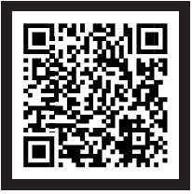
Reminders!
Complete the form to receive your THANK YOU gift by December 20
Cookie Central is your online, one-stop hub for all things cookies!
  Online & print resources
  Online Cookie Systems Guides/Help Center
  Rewards information
  Find more here!
We are here to support you!
Notes:
Jen –
Thank you, Marisa! Before we go, we have just a few reminders to pass along:
As a thank you for participating in this training, Community Product Leaders will receive a bogg-inspired tote bag that is perfect for cookie season and beyond! To receive the tote, please complete the form which will be included in our post-training email. The deadline to fill out the form is by end of day December 20th.
And don’t forget that Cookie Central is your one-stop hub for all things cookies; print & online resources, the online Cookie systems guides and help center for families, rewards information, and more!
Last, all of us at Girl Scouts River Valleys are here to support you. Don’t hesitate to reach out when you need reassurance, guidance, and encouragement - we are truly all in this together and all for our Girl Scouts!
(LINK FORM IN Q&A)

Slide 54
Online resources available on Cookie Central:
The Cookie Press
Community Product Leader Guidebook
Editable presentations will be available for download under the Community/Area Product Leader resources in Cookie Central mid-December:
Overview
Engaging Girl Scouts & Families
Managing the Cookies
Managing Cookie Finances
Smart Cookies & Digital Cookie
Troop Cookie Manager Guidebook
Troop Cookie Companion
Cookie Booth Guide
Cookie Business Family Meeting PDF
Cookie Business Meeting Tip Sheet
Cookie Rally Order Form
Do Not Contact List & Newly Available for Troop-Secured List
My Cookie Inventory Worksheet – available on the back of the Family Guide & coming soon to Cookie Central
Easy Baked Cookie Program–New Leader Checklist under Troop Start-Up Resources and Printable Resources on For Cookie Sellers
Troop Training Toolkit coming soon!
Resources
with
Links
Notes:
Jen – as we’ve mentioned at the beginning of this training, every resource we have talked about today can be found on the following slides. We’ll post this training, with the editable PowerPoint, on Cookie Central by December 13. We hope these slides will help you to quickly and easily access the resources you need.

Slide 55
Finance Resources – also available on Cookie Central:
  Troop Cookie Manager Responsibility Form
  Family Cookie Responsibility Form
  Automated Clearing House (ACH) FAQ’s
  Finance/Inventory Issue Form
Resources
with
Links

Slide 56
Online Systems Resources:
gsLearn
477 Looker for Volunteers GSLearn
Online Cookie Systems Guide for Volunteers
Live on Cookie Central mid-December
Digital Cookie
Digital Cookie Help Center for Girl Scouts and Families – 2025 updates live on Cookie Central mid-December
Smart Cookies
Managing Cookie Donations in Smart Cookies Tip Sheet
Smart Cookies Help Desk for Volunteers:
ABCSmartCookieTechSupport@hearthsidefoods.com
855-444-6682
Cookie Calculator
Resources
with
Links

Slide 57
Council Wide Community Product Leaders – GSRV Rally
Council Wide Troop Product Program Volunteers - GSRV Rally
Rallyhood Cookie Swaps:
Central Regional
Hutchinson, New Ulm, New Prague, Mankato, Blue Earth, surrounding areas
East Metro
Cities in the northeast metro, which could include cities east of 35W and north of 94: Saint Paul, Roseville, Maplewood, Hudson, Forest Lake, etc.
North Metro
Forest Lake (NE 12), Anoka (NE 2), Monticello (North 12), Maple Grove (North 11), and the surrounding area
North-Northwest Regional
Canby (NW 1), Marshall (NW 2), Redwood Falls (NW 3), and the surrounding area), Olivia, Buffalo Lake, Hector
Online
Resources:
Rallyhood

Slide 58
Rallyhood Cookie Swaps (cont’d):
South Metro
Cities east of 35W and south of 94: Saint Paul, Woodbury, Hastings, Farmington, etc.
Southeast Regional
Red Wing (SE 9), Rochester (SE 7), Austin (SE 1), Owatonna (SE 8) and the surrounding area
Southwest Regional
Pipestone (SW 1), Worthington (SW 2) Windom (SW 3), etc.
West Metro
Cities west of 35W and north of 394: Minneapolis, Brooklyn Center, Golden Valley, Blaine, Champlin, etc.
Wisconsin Regional
Wisconsin (Areas Wisconsin 1-7)
Online
Resources:
Rallyhood

Slide 59
Q&A Time
Join us for an optional Q&A time while we answer your questions.
An FAQ document will be sent out in an email to all attendees with answers to your questions.
Notes:
Tammy

Slide 60
PPAC Panel
Navigating as a first-year Community Product Leader
Mentorship opportunities
And more!
Notes:
Tammy – intorduce and ask the questions

